Slide 1
Quiz on Lecture 7
Please receive the quiz handout from Cyrille, Oliver, Vincent, Jan
Complete the quiz in silence
Hand the quiz back

Slide 2
Quiz on Lecture 7
What is true of an OLAP database:
  is supports quick CRUD transactions
  it uses columnar storage
  data are often normalized (e.g. 3NF)
  PostgreSQL is an OLAP database
The following databases utilize columnar storage:
  MySQL, Oracle, Google BigQuery
  Google BigQuery, Snowflake, DuckDB
  PostgreSQL, Google BigQuery
  PostgreSQL, DuckDB, Snowflake
Streaming is computationally efficient because:
  It eliminates the need for any data cleaning
  It requires less storage space
  Streaming is real time
  Only new data are processed & appended
An employee's role in the Dim_Employee table changes from 'Developer' to 'Manager'. To analyze project hours based on the role held at the time the work was done, which SCD method should be used for the 'Role' attribute?
  SCD Type 1: Overwrite the 'Role' from 'Developer' to 'Manager' in the employee's existing record.
  SCD Type 1: Add a new row for the 'Manager' role and delete the old 'Developer' row.
  SCD Type 2: Add a new 'Previous_Role' column to the existing record to store 'Developer'.
  SCD Type 2: Add a new row for the employee with the 'Role' of 'Manager', and mark the old 'Developer' row as inactive.
Kimball is suited for analytics because:
  The data are highly normalized (3NF)
  More joins need to be made at first
  The data in the dimension tables are not in 3NF, so there are more columns immediately available (fewer joins needed)
  There are no redundancies (i.e. repeated data)
Which characteristic is not associated with a Data Lake?
  Can store any type of data, structured and unstructured
  Possesses a flat structure with a GUID for each file
  Applies schema-on-write, requiring predefined schemas
  Objects are immutable once written, requiring rewriting for changes
A financial services company needs to retrieve the full transaction history for a single customer, which involves fetching all columns for about 50 records from a table containing billions of entries. Which database architecture would handle this specific request most efficiently and why?
  An OLAP system, because its column-oriented storage is optimized for scanning large volumes of data to quickly find the 50 specific records.
  An OLTP system, because its row-oriented storage keeps all data for a single record physically together, making the retrieval of a few full records extremely fast
  An OLAP system, because its use of denormalized tables like a star schema is designed to speed up queries that select many columns
  An OLTP system, because its normalized (3NF) design reduces data redundancy, making the storage footprint smaller and therefore faster to read from

Slide 3
Quiz on Lecture 7 (answers)
What is true of an OLAP database:
  is supports quick CRUD transactions
  it uses columnar storage
  data are often normalized (e.g. 3NF)
  PostgreSQL is an OLAP database
The following databases utilize columnar storage:
  MySQL, Oracle, Google BigQuery
  Google BigQuery, Snowflake, DuckDB
  PostgreSQL, Google BigQuery
  PostgreSQL, DuckDB, Snowflake
Streaming is computationally efficient because:
  It eliminates the need for any data cleaning
  It requires less storage space
  Streaming is real time
  Only new data are processed & appended
An employee's role in the Dim_Employee table changes from 'Developer' to 'Manager'. To analyze project hours based on the role held at the time the work was done, which SCD method should be used for the 'Role' attribute?
  SCD Type 1: Overwrite the 'Role' from 'Developer' to 'Manager' in the employee's existing record.
  SCD Type 1: Add a new row for the 'Manager' role and delete the old 'Developer' row.
  SCD Type 2: Add a new 'Previous_Role' column to the existing record to store 'Developer'.
  SCD Type 2: Add a new row for the employee with the 'Role' of 'Manager', and mark the old 'Developer' row as inactive.
Kimball is suited for analytics because:
  The data are highly normalized (3NF)
  More joins need to be made at first
  The data in the dimension tables are not in 3NF, so there are more columns immediately available (fewer joins needed)
  There are no redundancies (i.e. repeated data)
Which characteristic is not associated with a Data Lake?
  Can store any type of data, structured and unstructured
  Possesses a flat structure with a GUID for each file
  Applies schema-on-write, requiring predefined schemas
  Objects are immutable once written, requiring rewriting for changes
A financial services company needs to retrieve the full transaction history for a single customer, which involves fetching all columns for about 50 records from a table containing billions of entries. Which database architecture would handle this specific request most efficiently and why?
  An OLAP system, because its column-oriented storage is optimized for scanning large volumes of data to quickly find the 50 specific records.
  An OLTP system, because its row-oriented storage keeps all data for a single record physically together, making the retrieval of a few full records extremely fast
  An OLAP system, because its use of denormalized tables like a star schema is designed to speed up queries that select many columns
  An OLTP system, because its normalized (3NF) design reduces data redundancy, making the storage footprint smaller and therefore faster to read from

Slide 4
Designing and Deploying
end-to-end
Production Grade ML Applications
Lecture 8: Data Engineering — Dagster
October 2025
Oliver Angélil & Vincent Frimpong

Slide 5
Contents of three Data Engineering Lectures:
Lecture 6: Foundation and Building Blocks
  What is Data Engineering (DE)?
  The DE lifecycle
  Types of Data Architectures
  On-Prem vs Cloud (IaaS vs PaaS vs SaaS)
  Infrastructure as Code (IaC)
Lecture 7: The DE Lifecycle in Depth
  Source Systems & Storage
  Ingestion
  Modeling, and Transformation
  Serving Data for Analytics, Machine Learning, and Reverse ETL
Lecture 8: Learning by Doing — Building your own DE Pipeline with Dagster
this lecture
Oliver

Slide 6
3.1 Dagster: What is Dagster?
OSS — 13K github stars as of August 2025. Official documentation.
Software for building Data Engineering & Data Science pipelines, that includes:
  data schedules
  UI (data lineage, jobs, previews of data, etc)
  data health checks
  IO manager (where to read/write from)
Comparable alternatives: Palantir Foundry; GCP Dataplex, Apache Airflow
Example of a DAG:
Raw
Clean
Aggregated
Date (STR) | Food Item (STR) | nItems (STR)
2023-01-15 | Applle | 200
Feb 3, 2023 | Aubergine | 400.0
30.02.2023 | Eggplant | eighty
Feb 4, 2023 | Apple | five
Date (DATE) | Food Item (STR) | nItems (INT)
2023-01-15 | Apple | 200
2023-02-03 | Eggplant | 400
NULL | Eggplant | 80
2023-02-04 | Apple | 5
Food Item (STR) | Sum nItems (INT)
Apple | 205
Eggplant | 400
Flow of Data
Oliver

Slide 7
3.1 Dagster: What is Dagster?
When it comes to data, almost everything is a DAG! Step 1 -> Step 2 -> Step 3 -> Step N
More examples of what DAGs can be used for:
Manually Triggered Jobs:
  AIMS MSc theses:
    raw data from supervisor
    clean
    transformed / feature engineering
    ML models
  Orders/Product Reporting:
    ingest orders & product data
    join tables to enrich orders ("fact table") with product properties (from "dimension table")
    aggregating. e.g. groupby("orderID", "date") .agg(countdistinct("product_category"))
    serving for Tableau / PowerBi
    send email with link to fresh data for download
Scheduled Jobs (for real time data):
  Weather App:
    download weather data from API
    clean data
    transform data
    serve to UI (PowerBi / Plotly / Streamlit)
    send notification in slack when heat wave occurs somewhere in the world
    run on schedule (hourly)
  Fraud Detection:
    live transaction data
    preprocessing / cleaning
    train ML classifier
    deploy on cloud
    monitor live transactions (ML inference) in real time (streaming)
    run on schedule (e.g. every minute)
Oliver

Slide 8
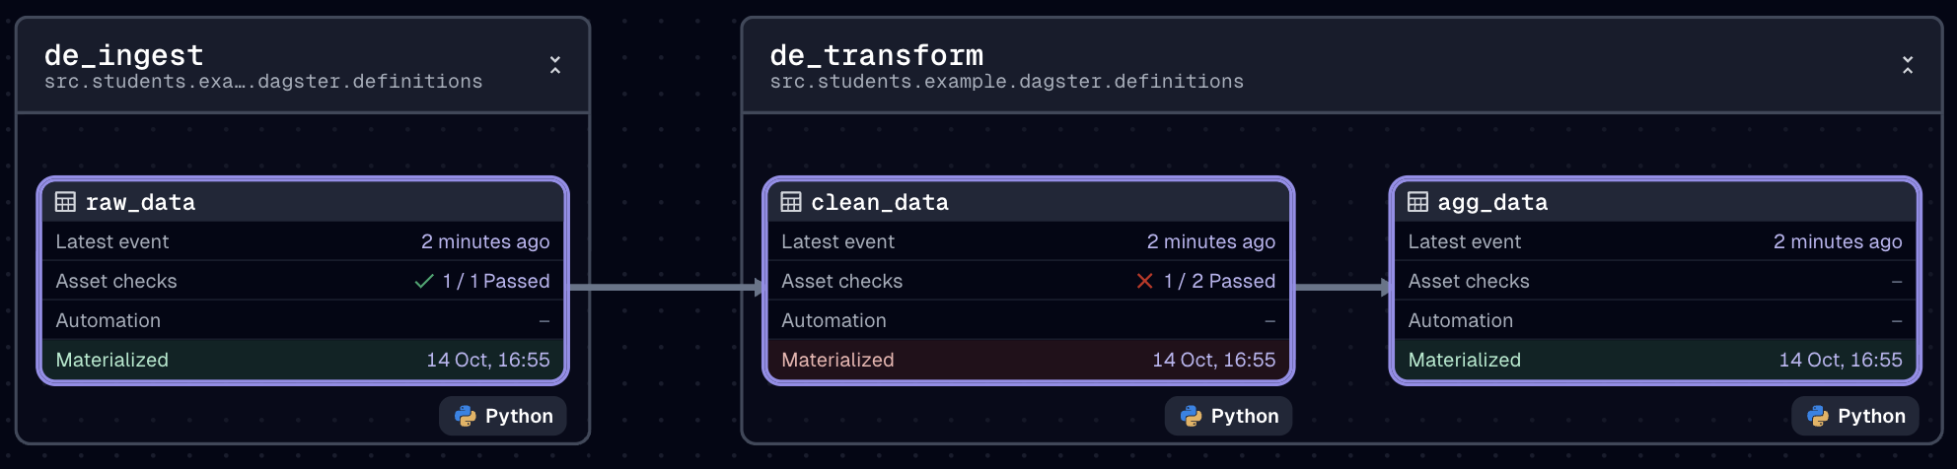
3.2 Dagster: A simple example
Please each run the Data Engineering job on your computers.
See code here.
It produces this DAG:
To run it yourself:
  type ./run_dagster.sh in the terminal
  open the UI running in port 3000
  click on "jobs" and select "simple_data_engineering_example"
  click "Materialize all"
  hover over "3 assets" and click "View lineage"
  watch each asset build in real time!
Vincent

Slide 9
3.3 Dagster: Concepts — assets (see documentation)
Definition: "An asset represents a logical unit of data such as a table, dataset, or machine learning model. Assets can have dependencies on other assets, forming the data lineage for your pipelines"
In our example, we have 3 assets:
  raw_data
  clean_data
  agg_data
An asset is defined using the @dg.asset decorator. Here is the code for the clean_data asset:
@dg.asset(
description="my clean data",
compute_kind="python",
group_name="de_transform"
)
which is immediately followed by a function whose name will be used as the asset name:
def clean_data(
context: dg.AssetExecutionContext,
raw_data: pd.DataFrame
) -> dg.MaterializeResult:
{transformation logic}
return dg.MaterializeResult(
value=clean_data,
metadata={...}
)
Vincent

Slide 10
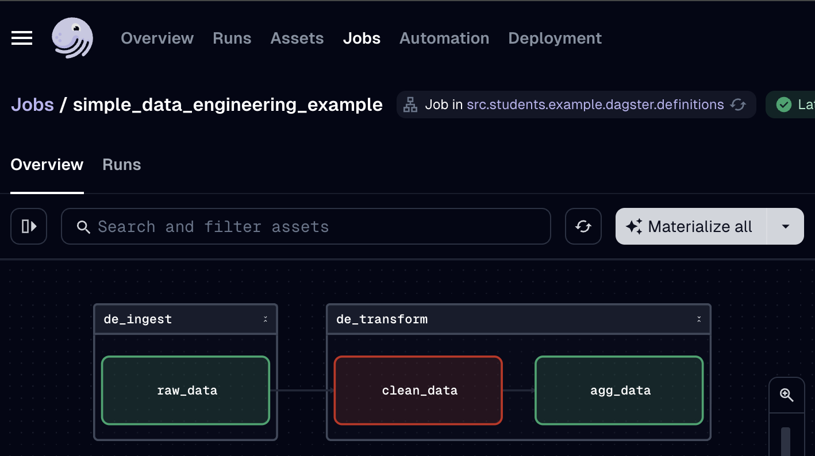
3.3 Dagster: Concepts — asset checks (see documentation)
Definition: "An asset_check is associated with an asset to ensure it meets certain expectations around data quality."
In our example, we have 3 checks:
  all strings in the FoodItem column in raw_data should only contain alphabet letters
  all dates in the Date column in clean_data should not be null
  all integers in the nItems column in clean_data should be greater or equal to 0.
Checks are defined using the @dg.multi_asset_check decorator
As an example, we have purposefully made one of the checks fail:
Vincent

Slide 11
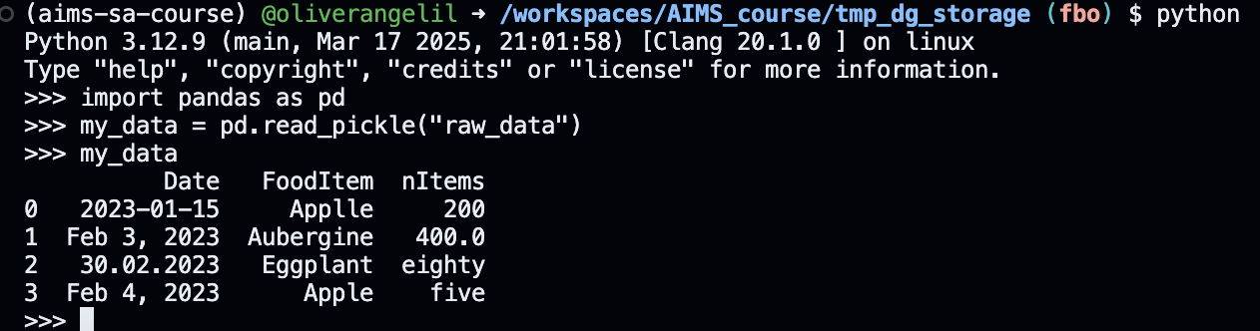
3.3 Dagster: Concepts — IOManager (see documentation)
Definition: "An IOManager defines where data is stored and retrieved"
In definitions.py we define the IOManager:
"io_manager": dg.FilesystemIOManager(base_dir="./tmp_dg_storage"). This means that all assets are saved locally in tmp_dg_storage as pickle files:
We use the most basic IOManager (FilesystemIOManager) to save files locally. Dagster has many different IOmanager options. Some are:
  s3.S3PickleIOManager (Stores outputs as pickle files in Amazon Web Services S3)
  GCSPickleIOManager (Stores outputs as pickle files in Google Cloud Platform GCS)
  DuckDBPandasIOManager (Stores Pandas DataFrame outputs in DuckDB.
  etc
Vincent

Slide 12
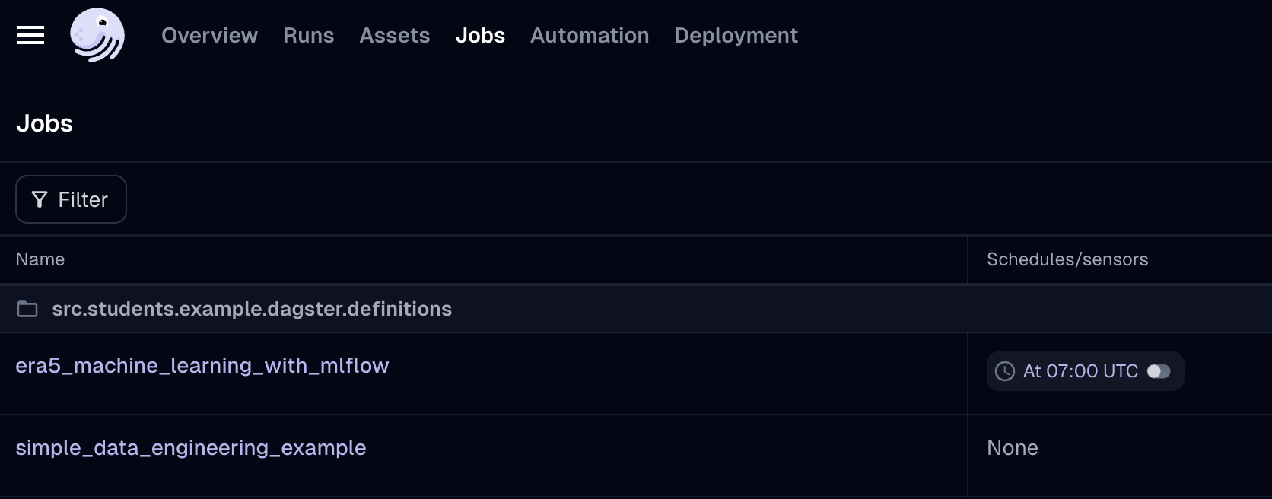
3.3 Dagster: Concepts — Jobs (see documentation)
Definition: "A job is a collection of assets. Jobs are the main form of execution in Dagster."
In definitions.py:
de_job = dg.define_asset_job(
name="simple_data_engineering_example",
selection=dg.AssetSelection.groups("de_ingest", "de_transform"),
)
Select all assets that are part of two asset groups: de_ingest, de_transform
Name of job ("simple_data_engineering_example") is visible in the dagster UI:
Vincent

Slide 13
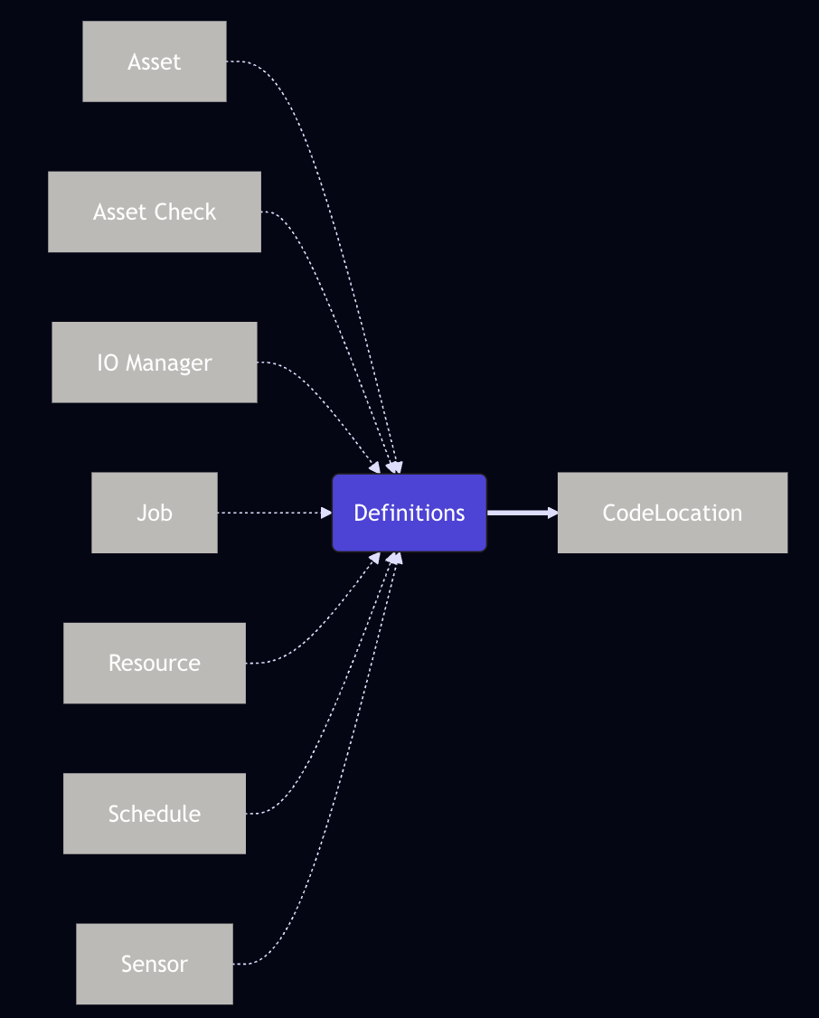
3.3 Dagster: Concepts — Definitions (see documentation)
Definition: "contains references to all the definitions ("concepts") in a Dagster project."
Bringing it all together in definitions.py:
defs = dg.Definitions(
assets=[*all_ml_assets, *all_de_assets],
resources={
"io_manager": dg.FilesystemIOManager(base_dir="./tmp_dg_storage"),
"mlflow_tracking": mlflow_resource,
"mlflow_client": mlflow_client,
"cds_api": CDSAPI(),
},
jobs=[de_job, ml_job],
schedules=[era5_daily_schedule],
asset_checks=[*all_de_checks, *all_ml_checks]
)
Contains everything needed for a dagster project!
More concepts not mentioned yet:
Resource: A ResourceDefinition is a way to make external resources (like database or API connections) available to Dagster entities (like assets, schedules, or sensors) during job execution
Schedule: A ScheduleDefinition is a way to automate jobs or assets to occur on a specified interval
Sensor: A sensor is a way to trigger jobs or assets when an event occurs, such as a file being uploaded or a push notification.
Vincent

Slide 14
3.4 Dagster: Project Structure
definitions.py: This is the main entry point for your Dagster project. It brings together all the different parts of your project assets, resources, jobs, and schedules into a single “Definitions” object.
assets.py: This file contains the definitions of your data assets. Organizing in a dedicated file helps to keep your data pipeline logic separate from other parts of your project.
resources.py: This file is where you define resources, which are external services or connections that your assets need to do their work. For example, you might have a resource for connecting to a database, an API, or a cloud storage service. You can easily manage and configure these external dependencies eg. you can swap out a development database for a production one simply by changing the resource definition.
├── pyproject.toml
├── src
│ └── my_project
│ ├── __init__.py
│ └── dagster
│ ├── __init__.py
│ ├── definitions.py
│ ├── de
│ │ ├── assets.py
│ │ └── resources.py
│ └── ml
│ ├── assets.py
│ └── resources.py
│ └── tests
│ ├── tests.py
├── tests
│ └── __init__.py
└── uv.lock
Vincent

Slide 15
Assignment 2
Build an end-to-end Fraud Detection system with an Interactive UI
The goal is to use the Dagster pipeline demonstrated in the course as inspiration to design and implement a completely new pipeline that trains, validates, and deploys a machine learning model for credit card fraud detection.
Instructions:
Use the dataset available at this link: use pd.read_csv(url) to read the data.
Split the data into 80% training and 20% test.
On the 80% training, use 3-fold cross-validation to tune the hyperparameters (gridsearch) using a RandomForest Classifier. Log all trials as MLflow nested runs ( Choose only one hyperparameter to tune). 20 points (add relevant screenshots to your PR description on github)
On the test asset (20% of data), generate a confusion matrix plot or any other useful plot for model evaluation and log it as an image artifact in MLflow. 10 points (add relevant screenshots to your PR description on github)
In the last asset in your dagster pipeline, send a message into the slack channel with the ML prediction performance on the test set (any classification metric of your choice, but indicate the metric in your slack message!) & your favourite emoji. Note that we don't care about the performance of your ML model! 20 points
Start a local server that listens on a specified port to serve your model. Test your model from the terminal and record a screenshot of the response. 20 points (add relevant screenshots to your PR description on github)
Deploy the last promoted model from MLflow, into a gradio application (see gradio heart disease app for inspiration). 20 points (include link to OpenAPI URL on GCP in your PR description on github)
Add anything else you can think of — be creative. 10 points (mention your addition in your PR description on github)
Final submission: in the slack channel, send us a link to your merged PR in github with all relevant screenshots & the GCP URL.

Slide 16
Assignment 2
Guidelines:
Make sure you are working from your feature branch
Create a new folder in the dagster folder, and call it "ml_fraud"
Create new dagster files in the "ml_fraud" folder. Be inspired by the code already in the "ml" folder
Create a new Dagster job called "fraud_detection" and add it to the main "Definitions" concept, so that it appears in the jobs tab in the Dagster UI
Make sure you edit definition.py file to include the new resources you added in your "ml_fraud" folder
Don't recreate this mlflow_resource in the resources.py file in the ml_fraud folder. Instead import directly from the ml folder
Tip: start small with one asset, then run the job in the Dagster UI. If it works, add another asset, and so on.
Raise a PR to merge your feature branch into the development branch
Merge the PR
Delete your feature branch from github immediately after merging
Final submission: in the slack channel, send us a link to your merged PR in github with all relevant screenshots & the GCP URL.
TIP: use GenAI to help you. But beware — it often gives rubbish code, especially dagster code since it is a new framework!

Slide 17
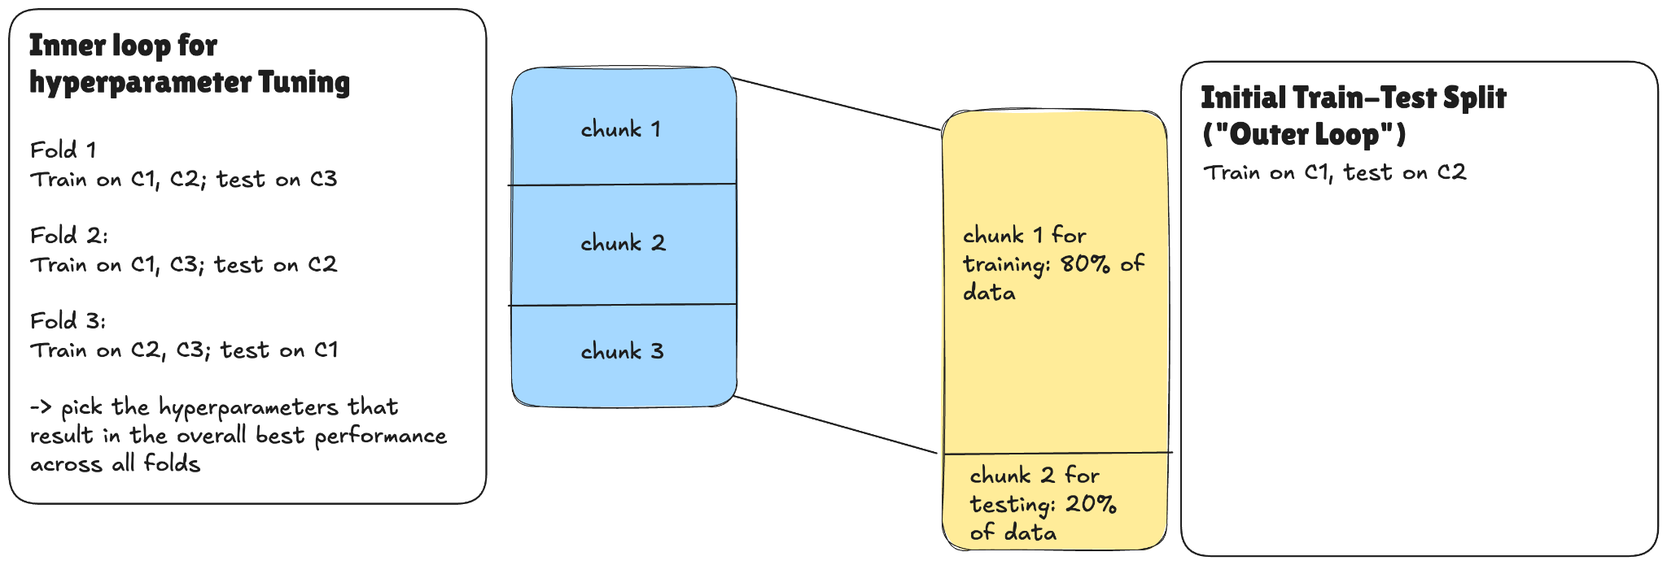
Assignment 2
Full starting
dataset

